Slide 1

CivicAI
AI-Powered Sustainability & Environmental Grievance Assistant bridging citizen reporting with structured community action.
PRESENTED BY
DEGREE & SPECIALIZATION
PRIMARY SDG FOCUS
Janhavi Garg
B.Tech CSE (AI/ML) | LPU
SDG 11: Sustainable Cities

Slide 2
Problem Statement
Common problems include water leakage and wastage, air pollution, improper waste disposal and uncollected garbage.
Students and citizens may not know the correct first step when an environmental problem occurs.
They may also be unsure where or how to report an unresolved issue.
Delayed or incomplete reporting can make environmental problems continue for longer.
Problem statement: How might we use AI to provide accessible sustainability guidance and structured environmental grievance support so that campuses and communities can become more sustainable?

Slide 3
Why This Problem Matters
Information gap: users may not have quick access to relevant sustainability guidance.
Action gap: users may be unsure what practical steps they can take first.
Reporting gap: complaints may be incomplete or missing important details.
Routing gap: the issue may need to reach campus maintenance or a civic authority.
CivicAI combines these steps in one conversational interface.
The aim is not to replace authorities, but to make communication clearer and easier.

Slide 4
SDG Alignment
Sustainable Development Goal | Project Focus Area | CivicAI Contribution & Impact
SDG 11: Sustainable Cities & Communities Primary | Smart civic services and sustainable campuses | Facilitates cleaner living spaces through fast reporting and organized community maintenance workflows.
SDG 6: Clean Water and Sanitation Supporting | Water wastage & pipeline infrastructure | Prioritizes prompt reporting of leaking faucets, broken valves, and stagnant water hazards.
SDG 12: Responsible Consumption Supporting | Waste sorting, collection, and recycling | Educates users on segregation while structuring complaints for overflowing bins and e-waste dumps.
SDG 13: Climate Action Supporting | Environmental pollution & emission control | Promotes community awareness on emissions, toxic burning, and actionable climate hygiene.

Slide 5


Target Users
Campus
Civic & Community
Students & Hostel Residents: Quickly report leaking taps, broken washrooms, and dirty common areas.
Local Neighborhood Residents: Seek immediate answers for waste collection schedules and pollution.
Faculty & Staff: Access verified sustainability knowledge and file clean institutional issues.
Community Volunteers: Drive civic clean-up initiatives armed with structured grievance data.
Campus Facility Management: Receive clean, pre-categorized tickets with full context.
Municipal & Civic Authorities: Incur fewer vague complaints through standardized routing.

Slide 6


AI Solution Overview
Conversational AI Engine
Knowledge & Retrieval (RAG)
IBM Granite: Generates accurate, empathetic, and natural conversational responses.
Curated Knowledge Base: Domain documents covering water saving, waste policies, and campus rules.
IBM watsonx.ai: Handles systematic prompt engineering, validation, and testing.
Context-Rich Augmentation: Relevant guides are injected into prompts before generation.
Intent & Category Classification: Detects whether the user wants advice or grievance routing across Water, Air, and Waste.
Fact Grounding: Eliminates hallucinations by anchoring guidance to authoritative sources.
Entity Extraction: Identifies location, duration, and severity automatically.
FAISS Vector Search: Lightweight vector indexing for sub-second retrieval.

Slide 7
Design Thinking Process
2. Define
4. Prototype
Identified the missing link: accessible DIY guidance coupled with structured reporting.
Engineered the full-stack system with IBM Granite, FastAPI backend, and React UI.
1. Empathize
3. Ideate
5. Test & Refine
Interviewed students and residents facing slow responses to everyday environmental hazards.
Conceptualized an AI conversational assistant leveraging RAG for ground-truth advice.
Evaluated with diverse issue inputs to optimize responsible AI and user confirmation.

Slide 8
CivicAI Step-by-Step User Workflow
Step 1: Conversational Input: The user reports an environmental issue in plain, everyday language (e.g., "Water is overflowing in block B").
Step 2: Practical Guidance First: CivicAI immediately provides safe, actionable steps (e.g., locate shut-off valve, notify floor warden) to curb immediate harm.
Step 3: Explicit Resolution Check: The assistant asks if the issue is solved. It only proceeds to generate a complaint if the user explicitly confirms assistance is required.
Step 4: Structured Routing: Automatically compiles missing details (exact location, duration) into a clean, standardized ticket for campus or municipal dispatch.

Slide 9
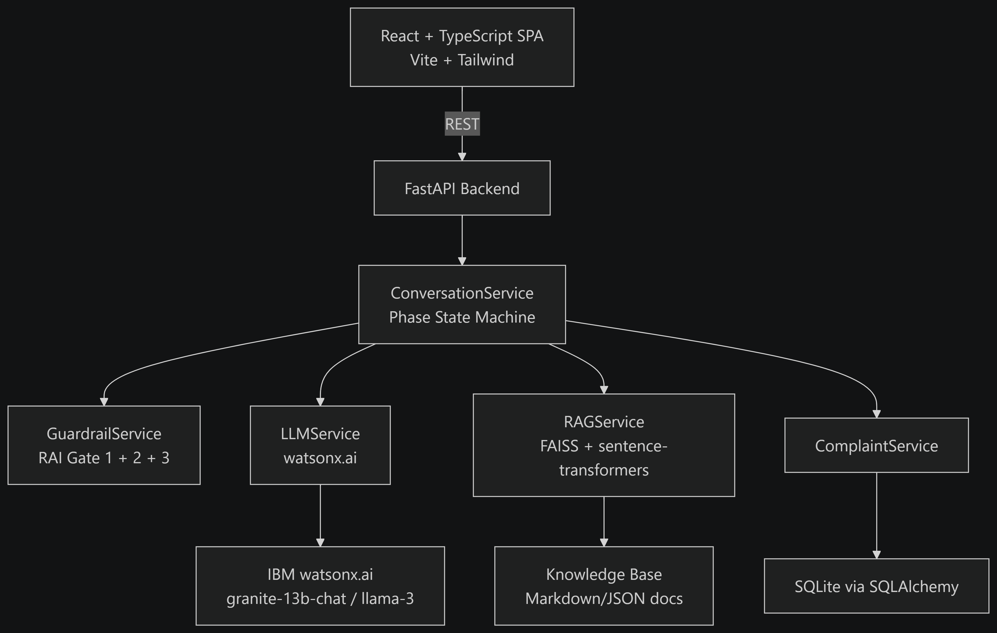
Architecture:

Slide 10
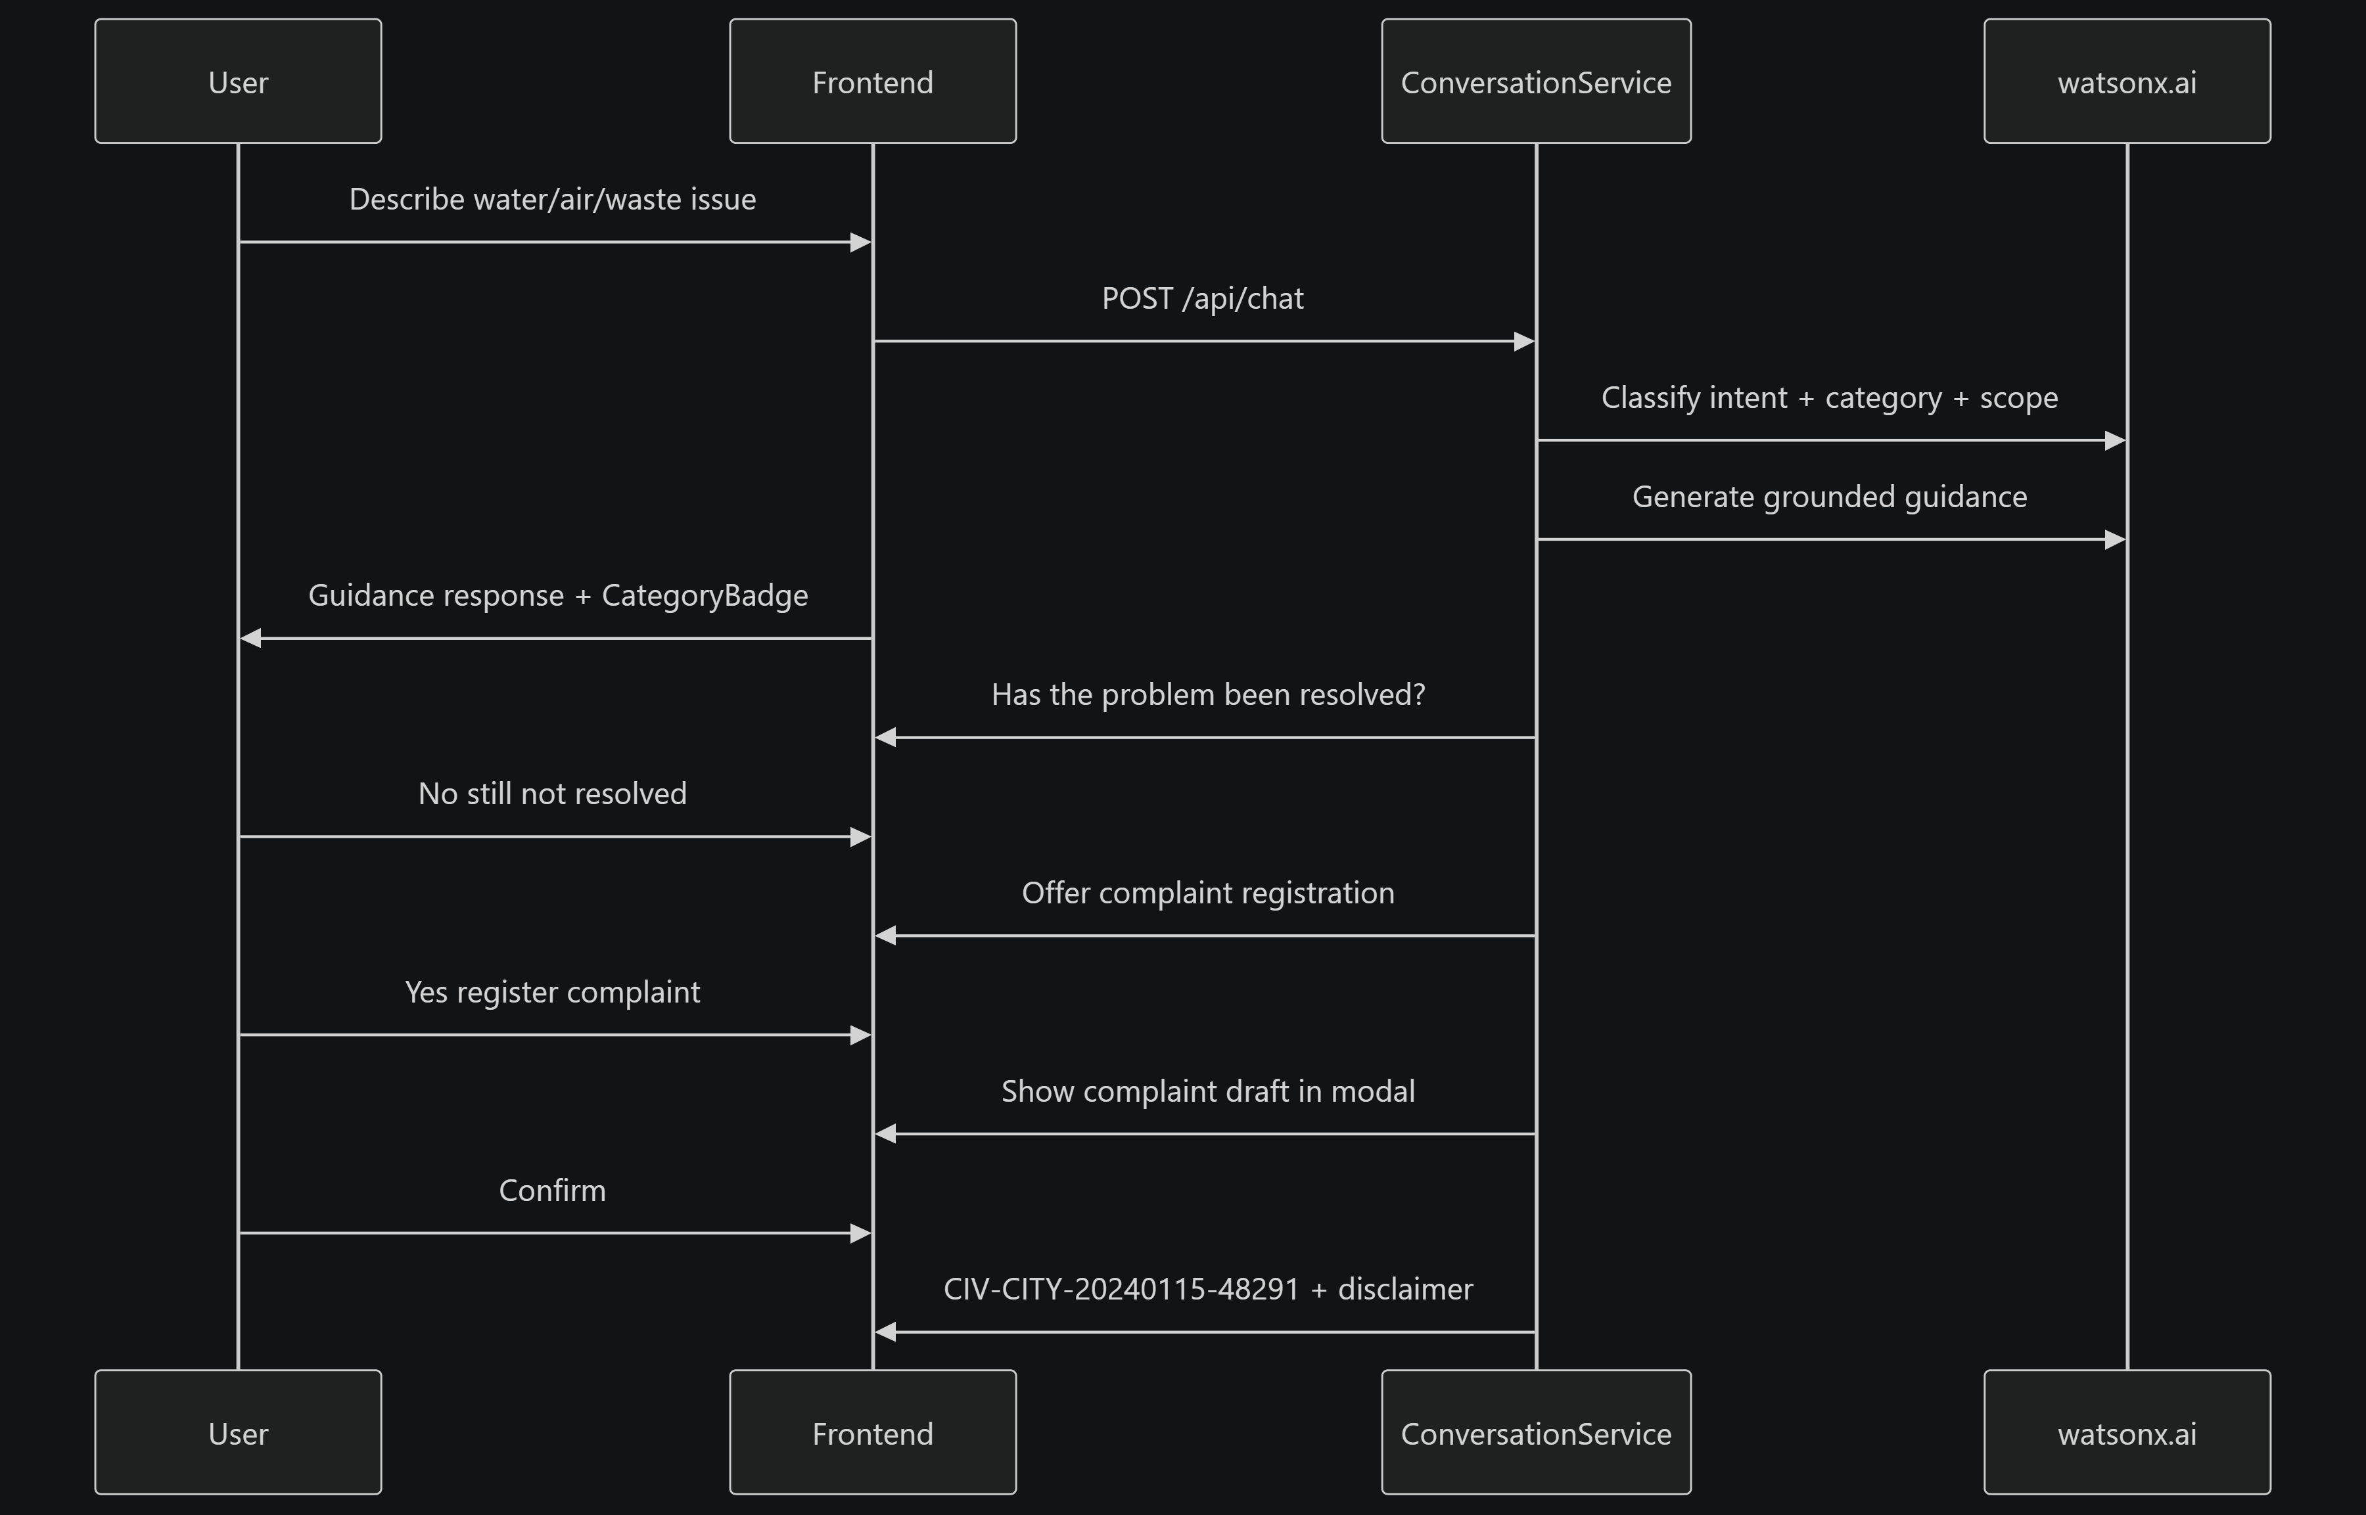
Conversation flow:

Slide 11
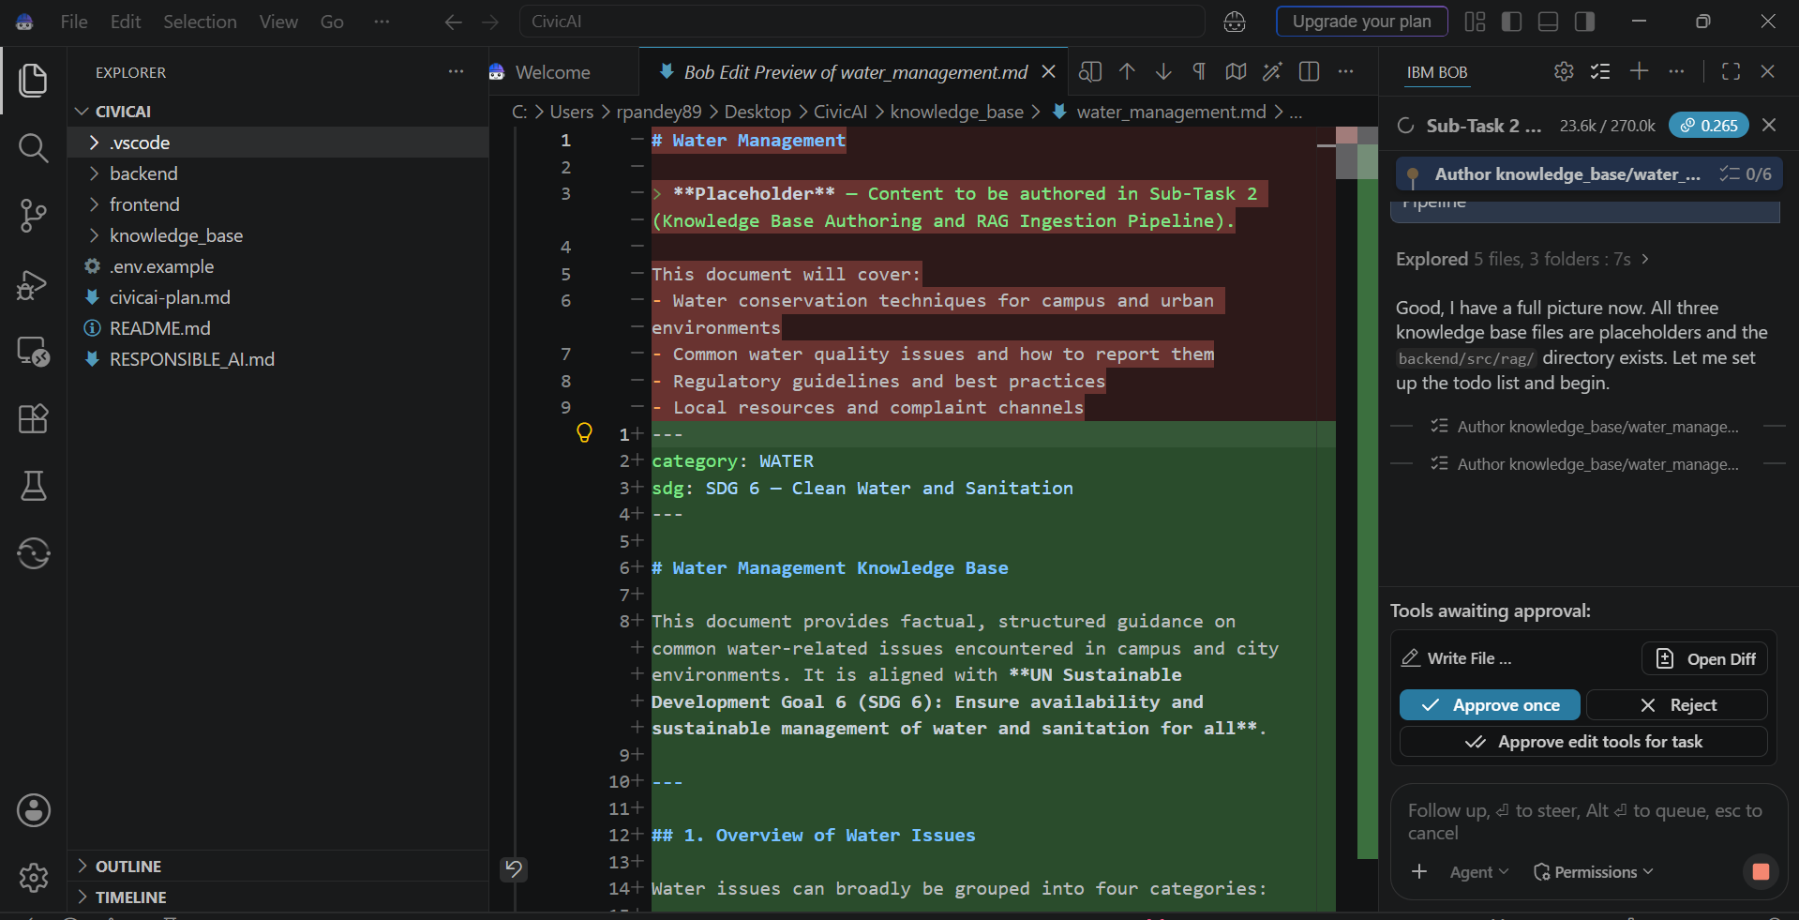
IBM BOB :

Slide 12
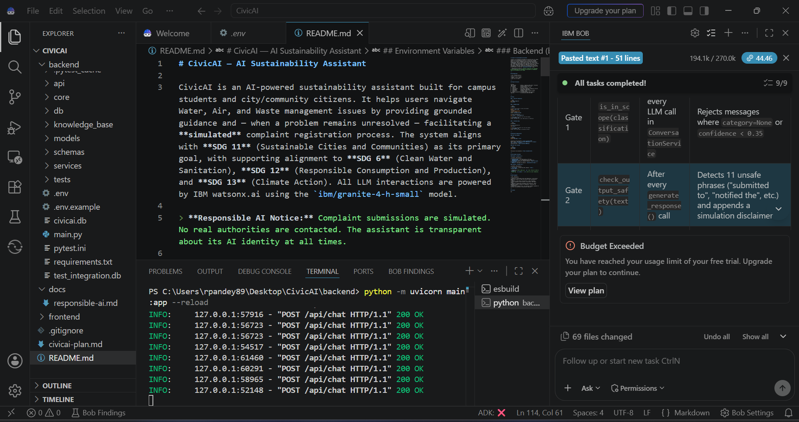

Slide 13
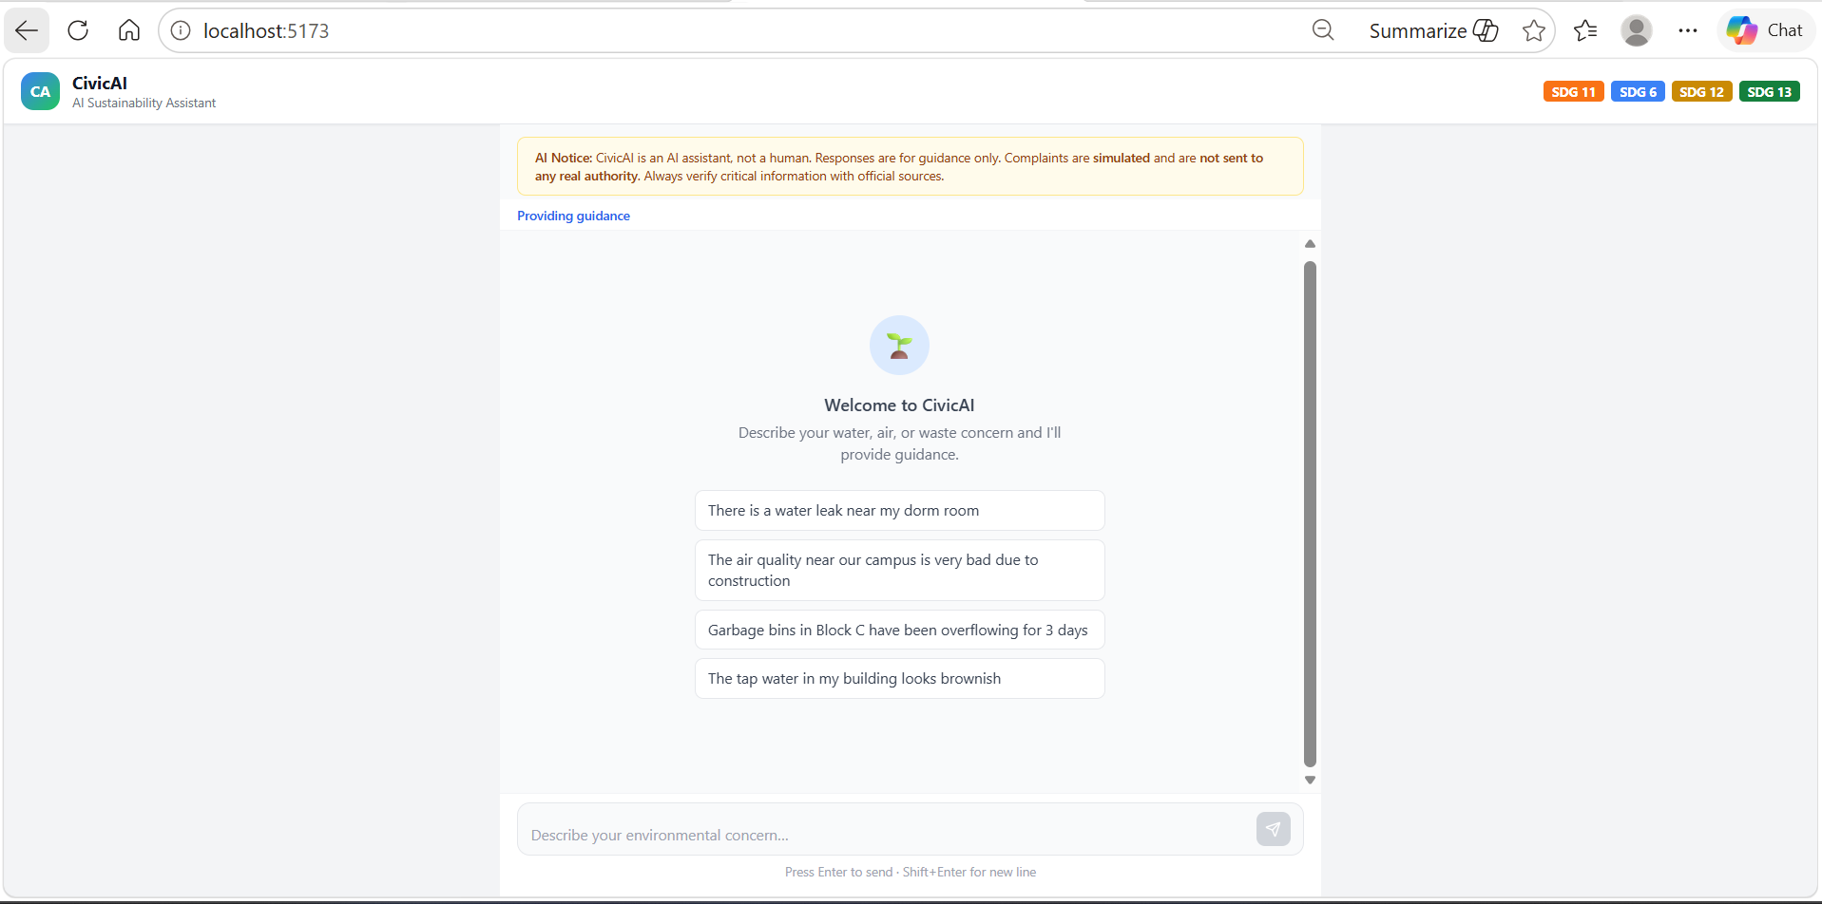
Project Demo:

Slide 14
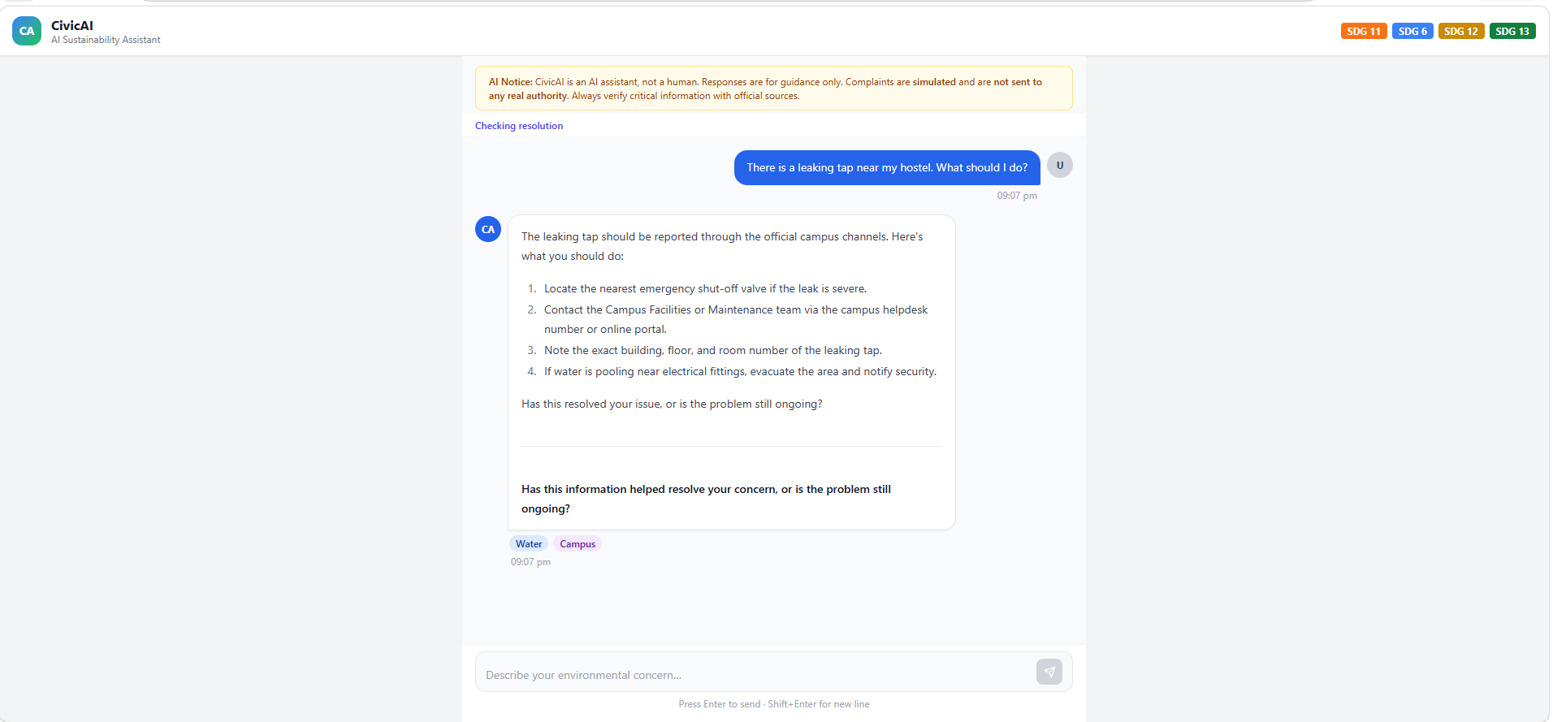

Slide 15
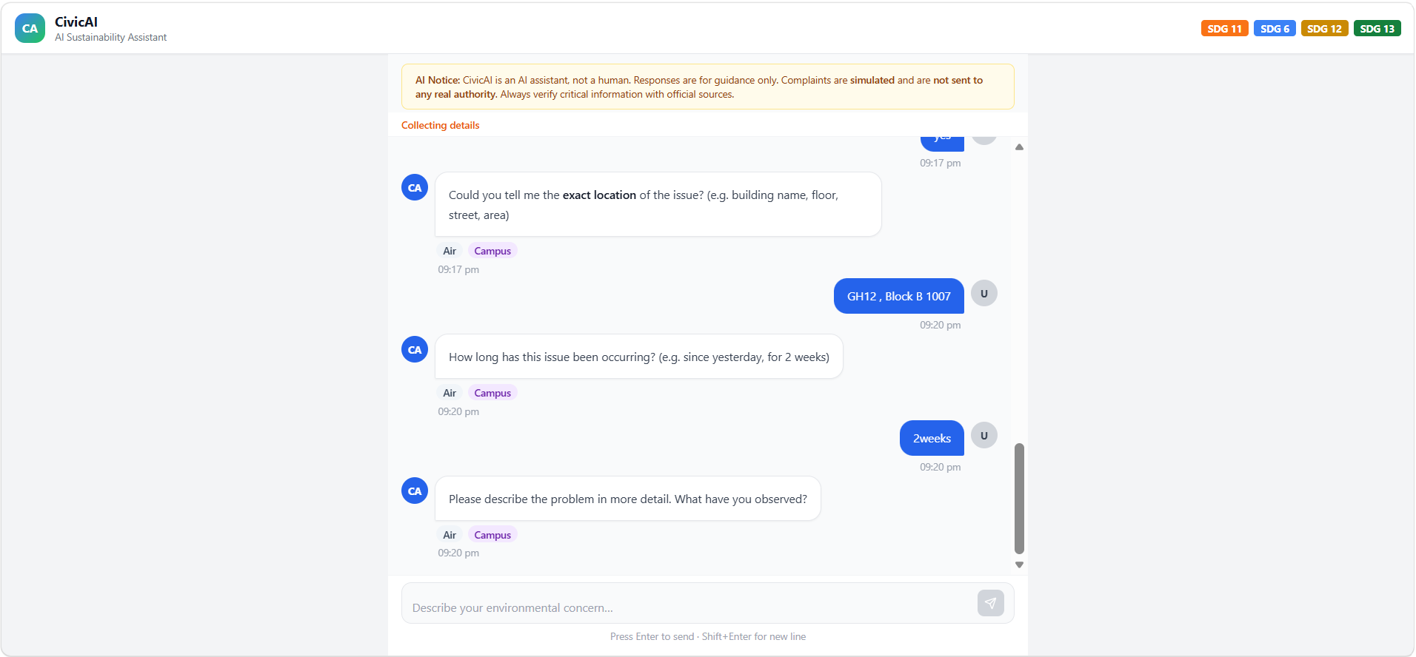

Slide 16
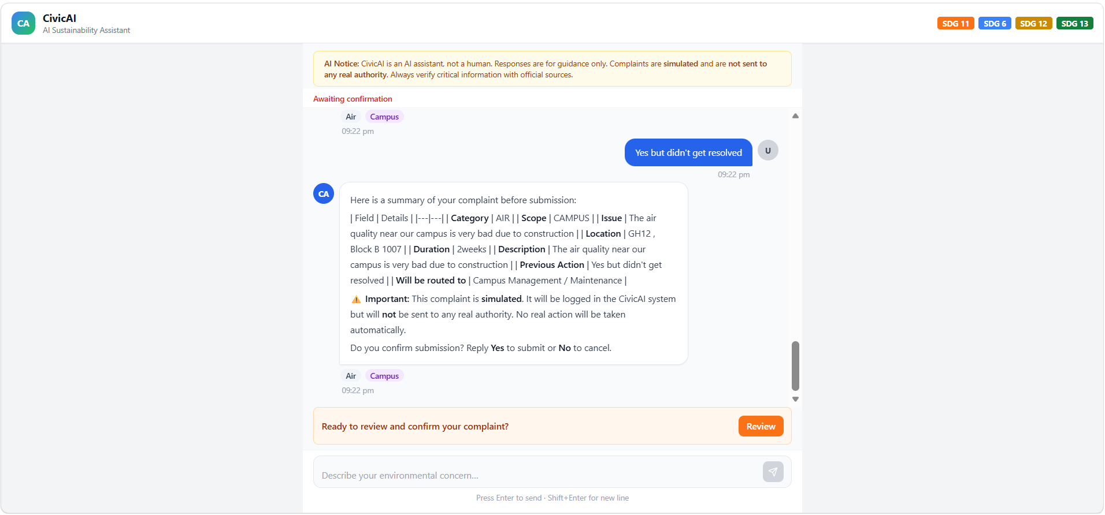

Slide 17
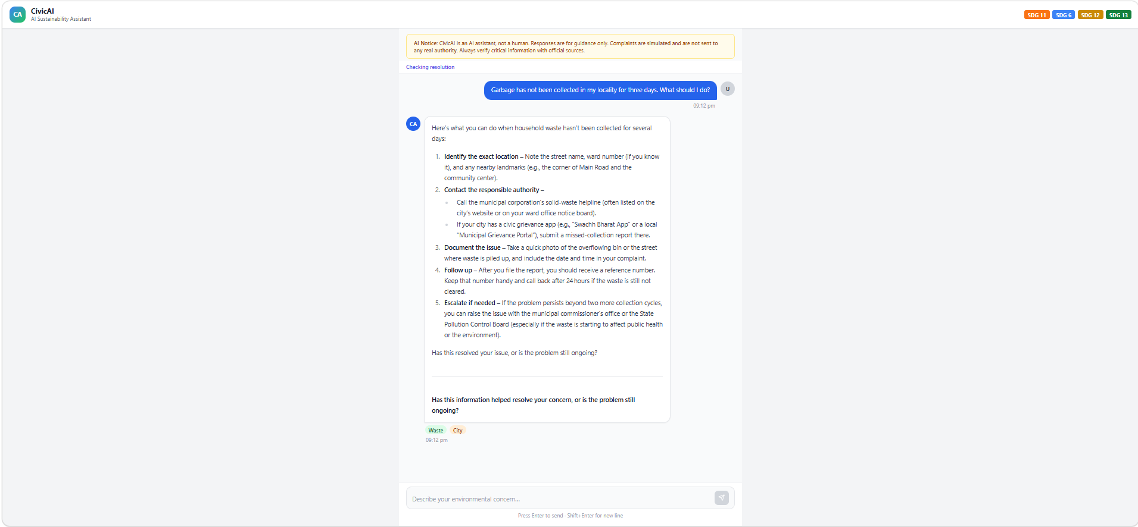

Slide 18
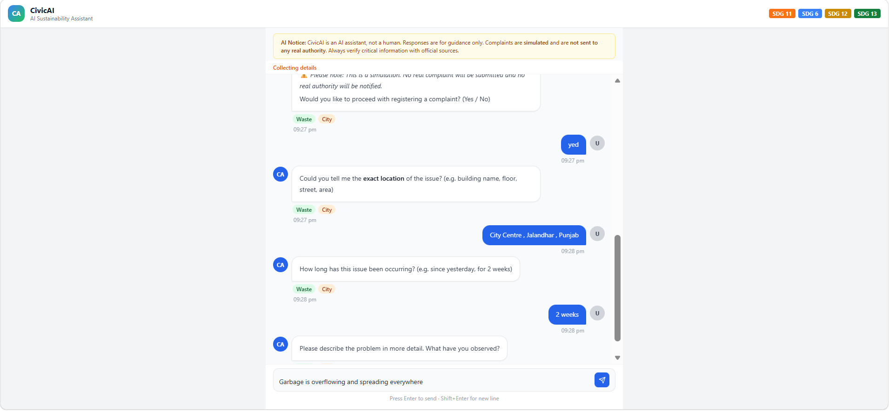

Slide 19
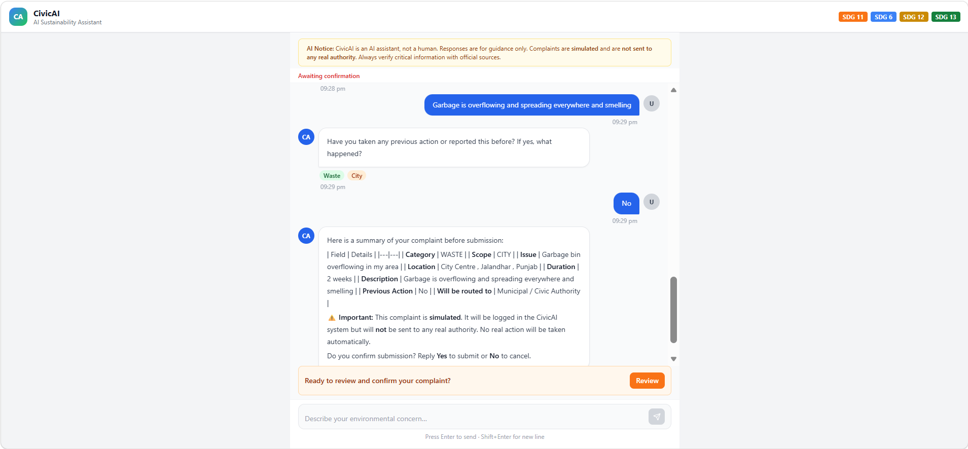

Slide 20


Technology Stack Overview
AI & Modeling
Backend & Data
Frontend & Deploy
IBM Granite & watsonx.ai: Natural language generation, prompt tuning, and structured classification. IBM Bob: Development and debugging acceleration.
FastAPI (Python): High-performance async REST APIs and grievance orchestration. FAISS & SQLite: Vector similarity search and structured complaint logging.
React + Vite: Clean, responsive, and mobile-friendly conversational interface. Render & GitHub: Automated CI/CD pipeline and accessible cloud hosting.

Slide 21
Responsible AI and Ethical Guardrails
Fairness, Privacy & Ethics
Unbiased Guidance: Equal treatment across all campus locations and socio-economic demographics.
Minimal Data Collection: Only gathers essential operational details; strictly avoids sensitive personal info.
Safety Guardrails: Prohibits dangerous DIY advice when dealing with electrical hazards or deep sewage.
Transparency & Human Control
Clear AI Identity: Informs the user upfront that CivicAI is an intelligent assistant, not a human officer.
User Confirmation Mandate: Complaints are never dispatched without explicit user review and agreement.
Explicit Simulation Tags: Prototypes visibly mark generated complaint tracking IDs as simulated.

Slide 22
Project Impact and Future Vision
Realized Impact
Behavioral Shift: Transforms passive observers into proactive campus eco-stewards.
Operational Efficiency: Reduces administrative triage by delivering structured, deduplicated tickets.
Future Enhancements
Integration with live municipal grievance portals & smart campus ERPs.
Image upload for automated vision-based waste and crack classification.
Vernacular Indian language support for inclusive community reach.

Slide 23
Thank You

